Slide 2
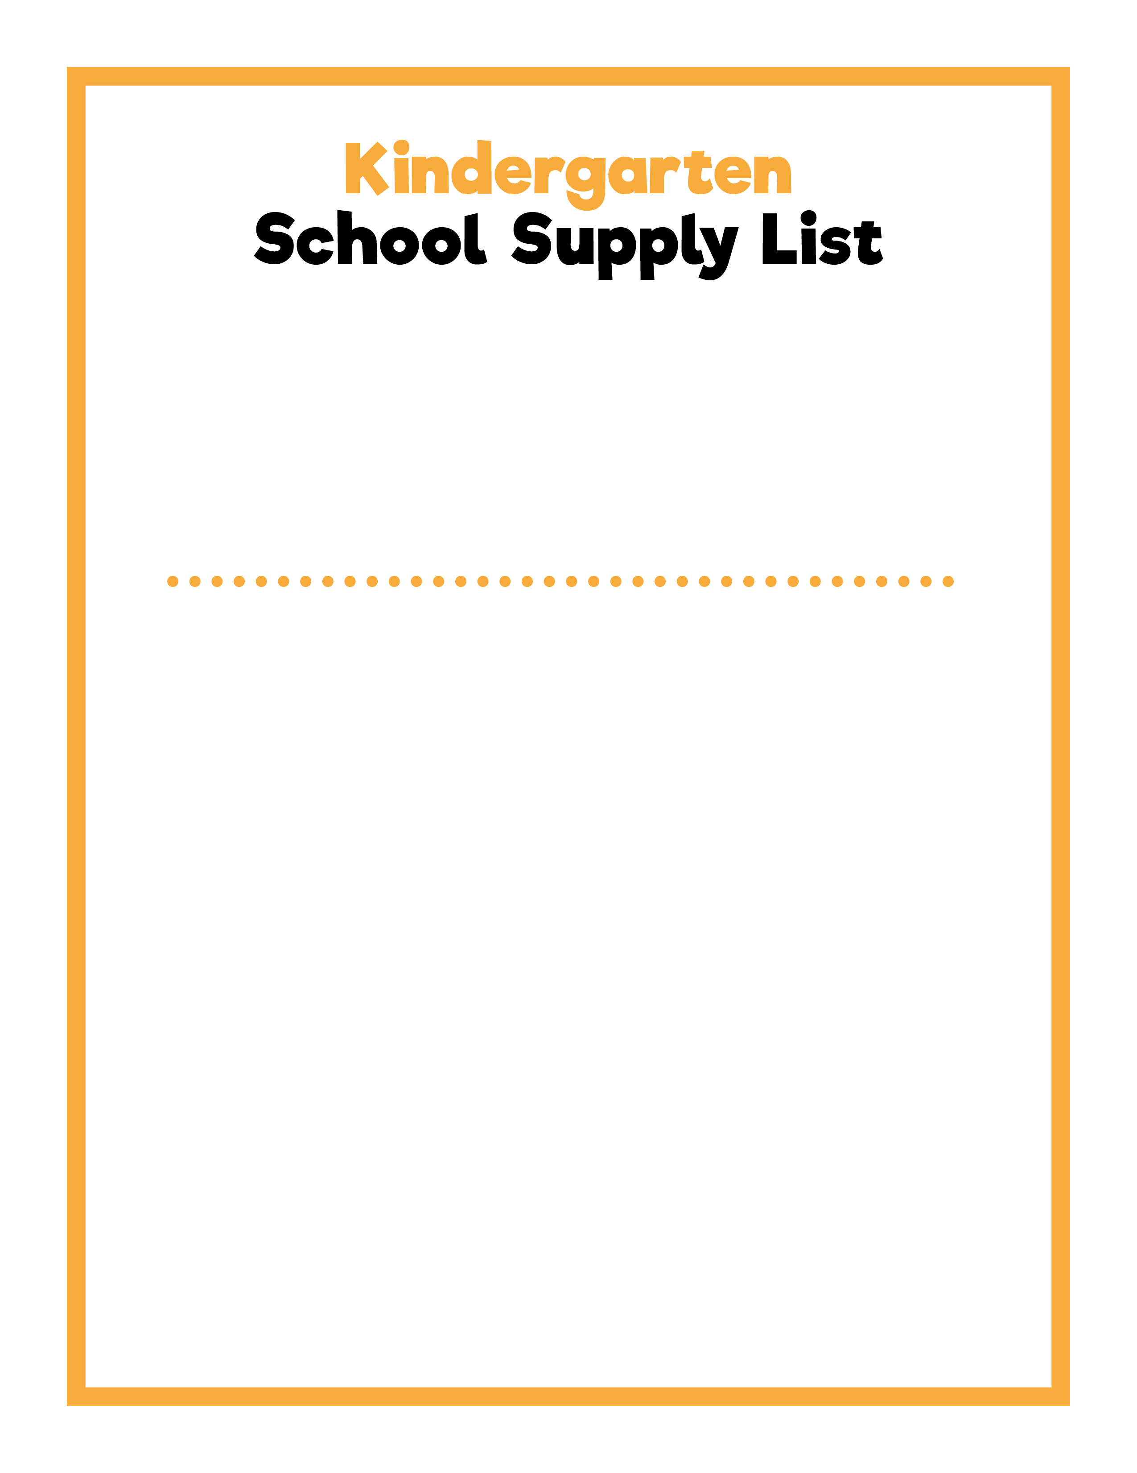
Dear Kindergarten Families,
I am so excited to be your child’s teacher for the 2021-22 school year. Please make sure your child has the following school supplies ready for the first day of school. I look forward to meeting your child and giving them the best ever start to school!
Sincerely,
NAME
Backpack
Lunchbox
Reusable water bottle
Pencil box
Two boxes of 12 sharpened No. 2 pencils
Personal pencil sharpener
One large pink eraser
Two boxes of 24 crayons
One box of 8 washable markers
Individual white board
One box of 4 dry erase markers
One pair of blunt-tip scissors
One bottle of white school glue
Six glue sticks
Two primary composition notebooks
Two two-pocket folders
Two boxes of tissue
One roll of paper towels
One container of baby wipes
One container of Lysol® Disinfecting Wipes
One box of plastic storage bags: gallon, quart, or sandwich
One pair of headphones
Extra set of clothes sealed in a gallon bag
Cloth mask

Slide 3
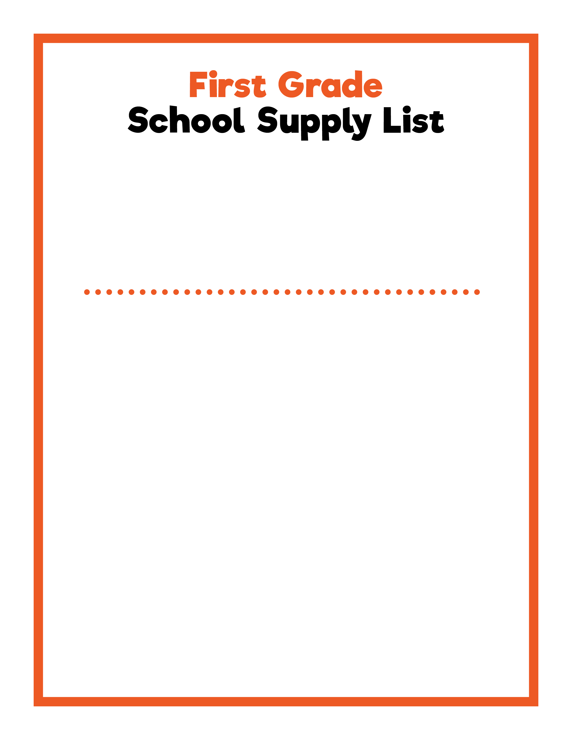
Dear First Grade Families,
I am so excited to be your child’s teacher for the 2021-22 school year. Please make sure your child has the following school supplies ready for the first day of school. I look forward to meeting your child and giving them the best ever start to school!
Sincerely,
NAME
Backpack
Lunchbox
Reusable water bottle
Pencil box
Two boxes of 12 sharpened No. 2 pencils
Personal pencil sharpener
One large pink eraser
Two boxes of 24 crayons
One box of 12 washable markers
Individual white board
One box of 4 dry erase markers
One pair of blunt-tip scissors
One bottle of white school glue
Six glue sticks
Two primary composition notebooks
Two two-pocket folders
Two boxes of tissue
One roll of paper towels
One container of baby wipes
One container of Lysol® Disinfecting Wipes
One box of plastic storage bags: gallon, quart, or sandwich
One pair of headphones
Cloth mask

Slide 4
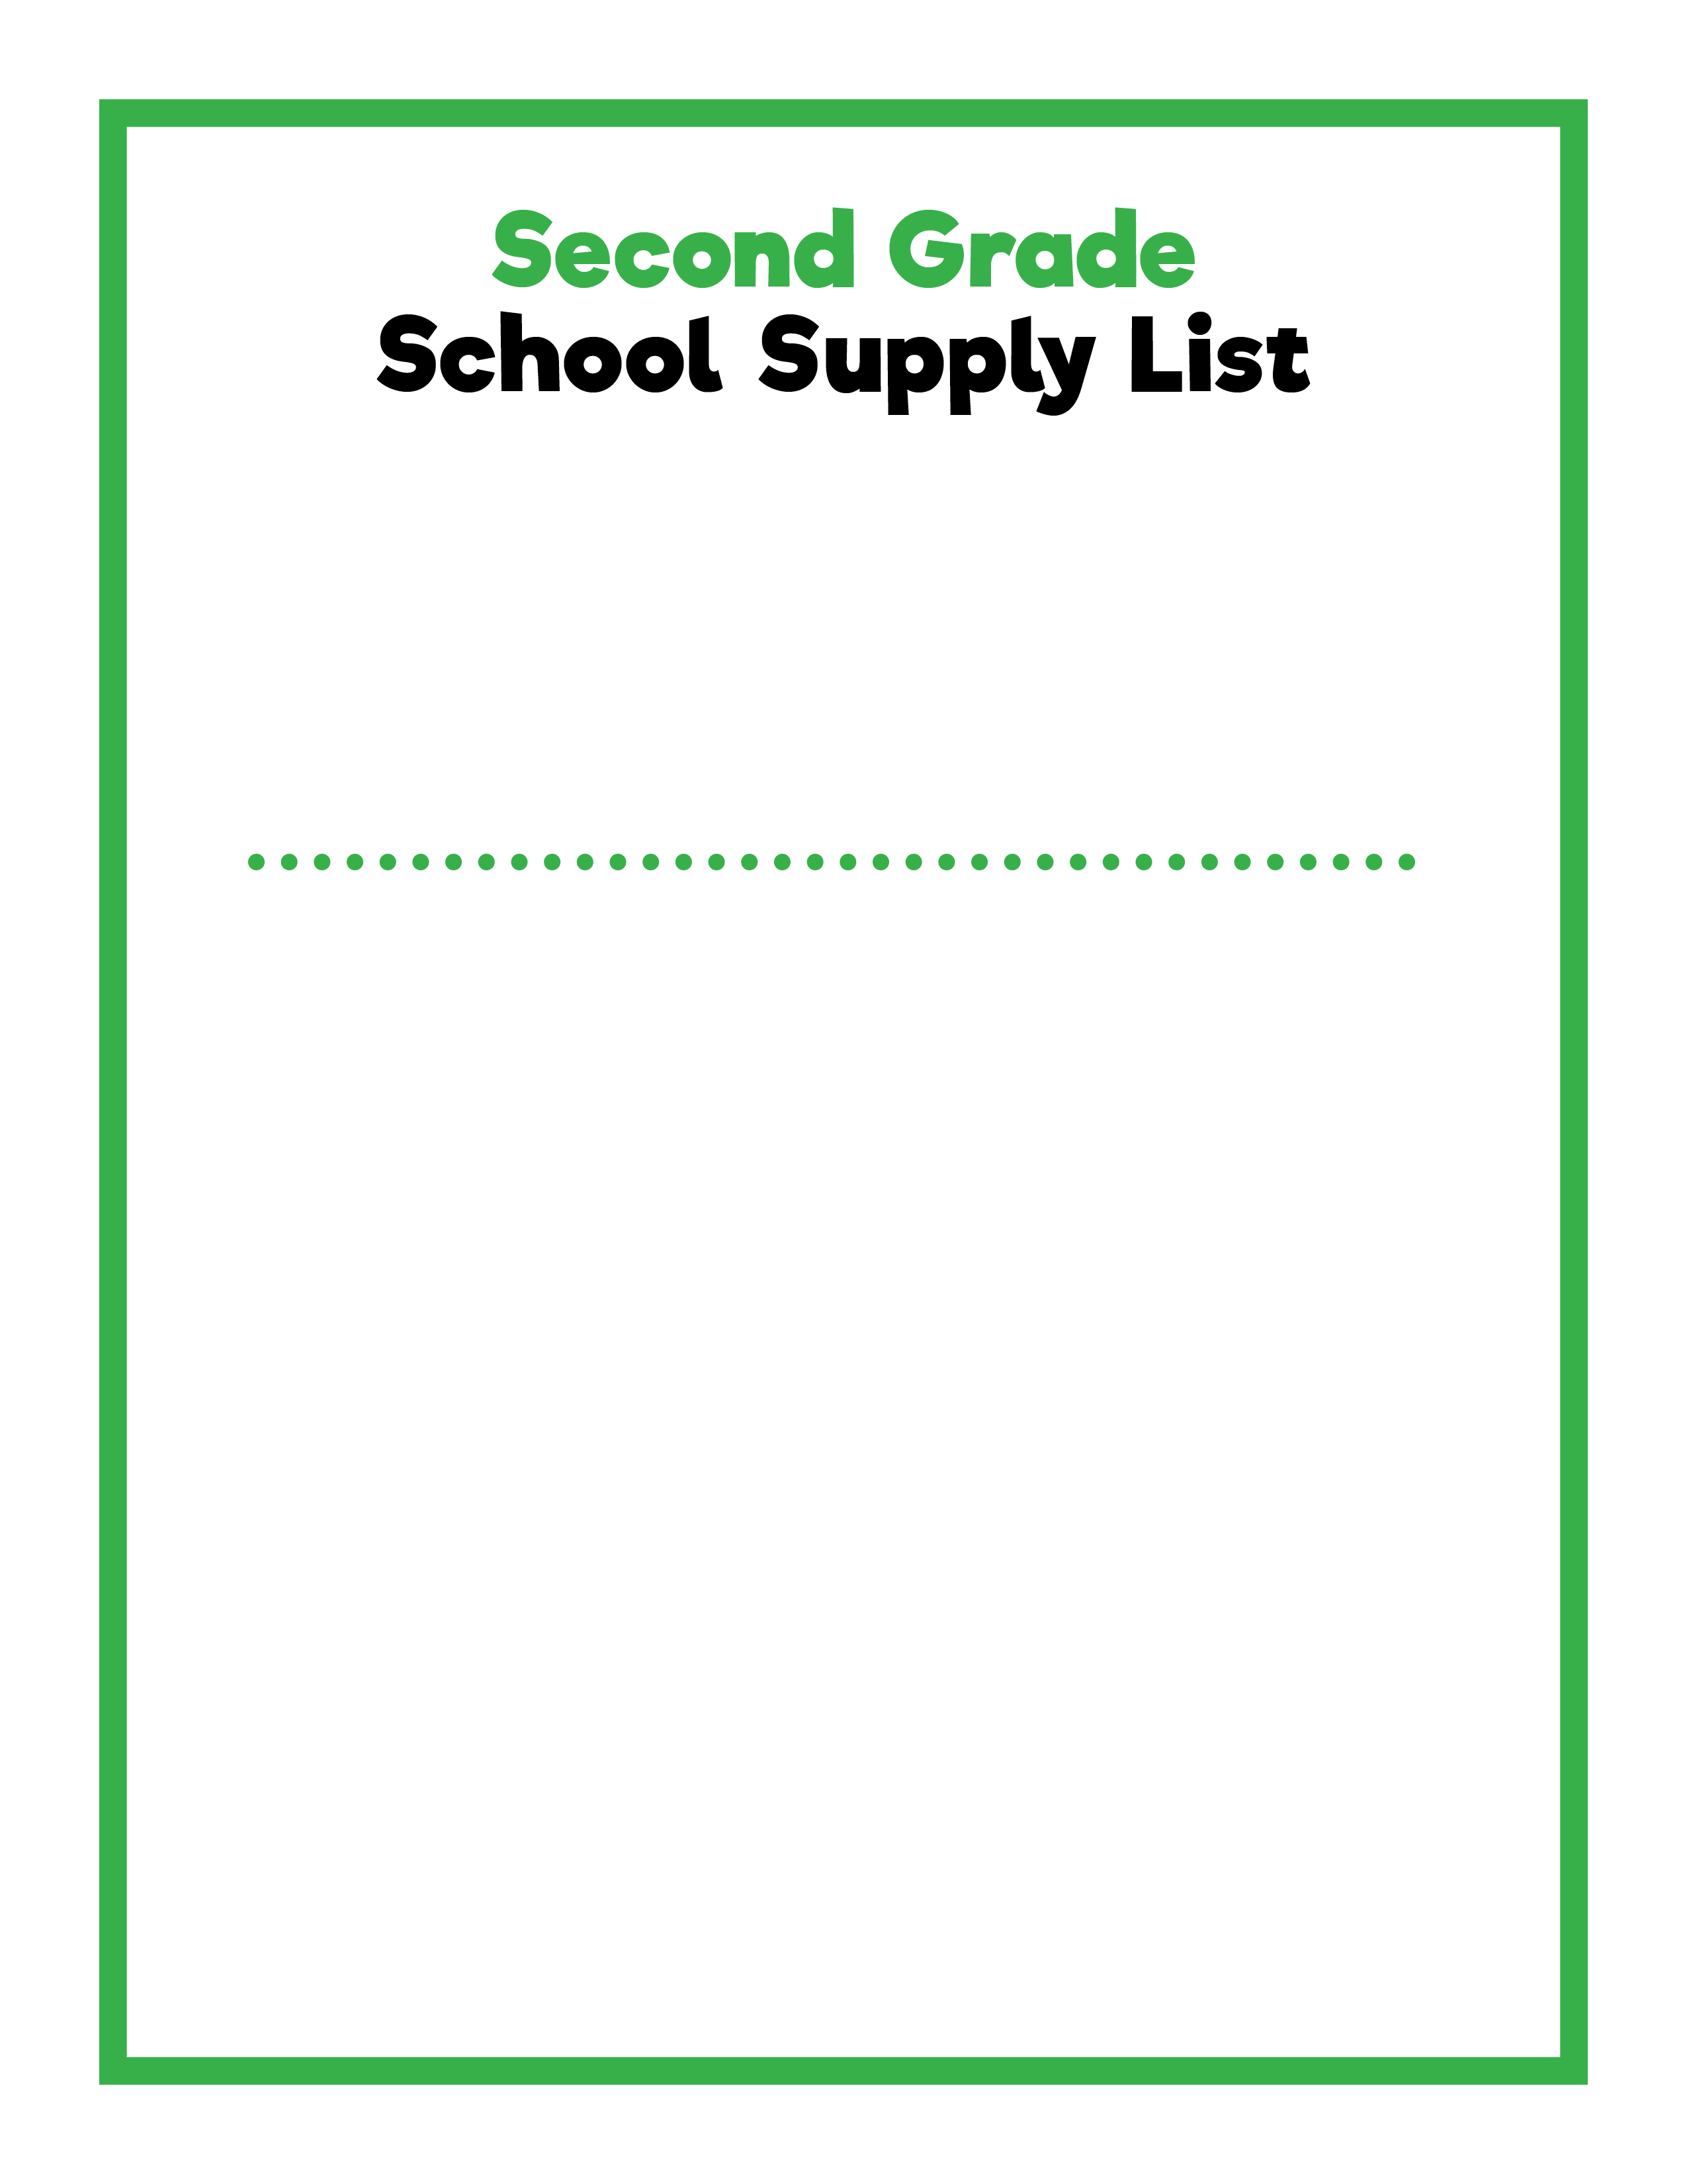
Dear Second Grade Families,
I am so excited to be your child’s teacher for the 2021-22 school year. Please make sure your child has the following school supplies ready for the first day of school. I look forward to meeting your child and giving them the best ever start to school!
Sincerely,
NAME
Backpack
Lunchbox
Reusable water bottle
Pencil box
Two boxes of 12 sharpened No. 2 pencils
Personal pencil sharpener
One large pink eraser
One box of 24 crayons
One box of 12 washable markers
Individual white board
One box of 4 dry erase markers
One pair of pointed-tip scissors
One bottle of white school glue
Six glue sticks
Ruler
Two primary composition notebooks
One pack of wide-ruled, loose leaf paper
Two two-pocket folders
Two boxes of tissue
One roll of paper towels
One container of baby wipes
One container of Lysol® Disinfecting Wipes
One box of plastic storage bags: gallon, quart, or sandwich
One pair of headphones
Cloth mask

Slide 5
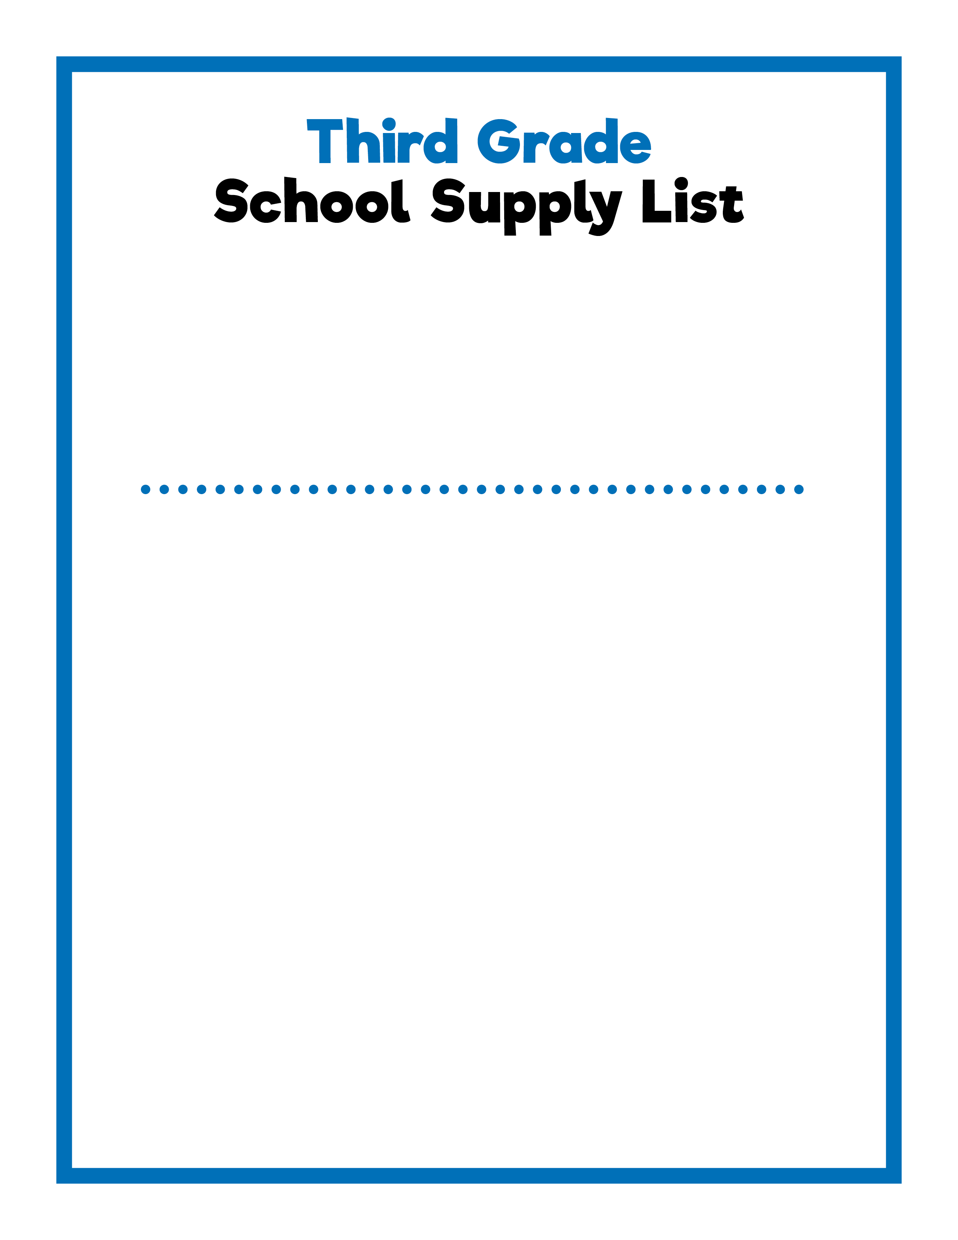
Dear Third Grade Families,
I am so excited to be your child’s teacher for the 2021-22 school year. Please make sure your child has the following school supplies ready for the first day of school. I look forward to meeting your child and giving them the best ever start to school!
Sincerely,
NAME
Backpack
Lunchbox
Reusable water bottle
Pencil box
Two boxes of 12 sharpened No. 2 pencils
Personal pencil sharpener
12 pink pencil top erasers
One box of 24 crayons
One box of 12 colored pencils
Individual white board
One box of 4 dry erase markers
Two highlighters
One pair of pointed-tip scissors
One bottle of white school glue
Six glue sticks
Ruler
Two wide-ruled composition notebooks
Three wide-ruled spiral-bound notebooks
One pack of loose leaf, wide-ruled paper
Two two-pocket folders
Two boxes of tissue
One roll of paper towels
One container of Lysol® Disinfecting Wipes
One box of plastic storage bags: gallon, quart, or sandwich
One pair of headphones
Cloth mask

Slide 6
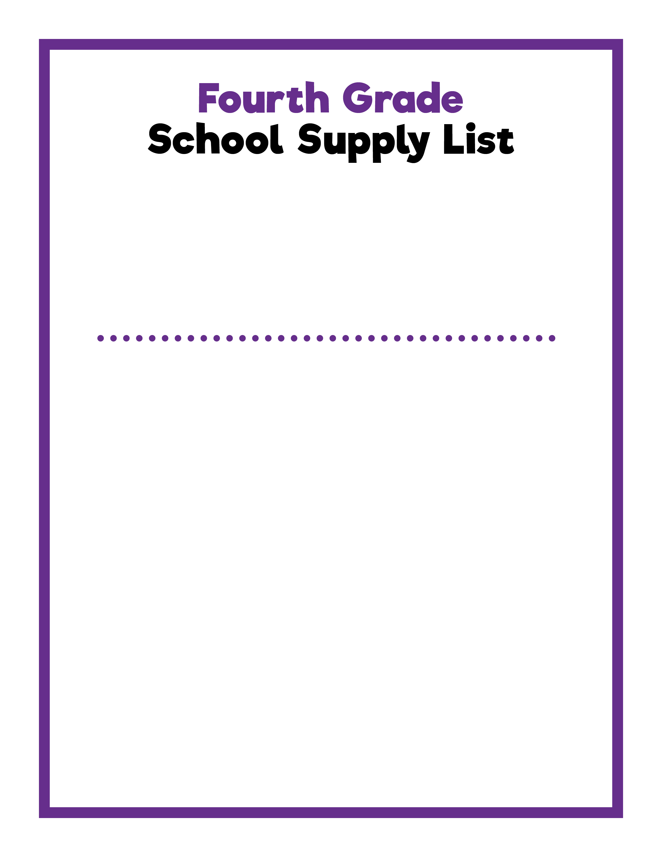
Dear Fourth Grade Families,
I am so excited to be your child’s teacher for the 2021-22 school year. Please make sure your child has the following school supplies ready for the first day of school. I look forward to meeting your child and giving them the best ever start to school!
Sincerely,
NAME
Backpack
Lunchbox
Reusable water bottle
Pencil pouch
Two boxes of 12 sharpened No. 2 pencils
Personal pencil sharpener
12 pink pencil top erasers
One box of 24 crayons
One box of 12 colored pencils
Individual white board
One box of 4 dry erase markers
Two highlighters
Two red pens
Two blue or black ballpoint pens
One black fine point permanent marker
One pair of pointed-tip scissors
One bottle of white school glue
Six glue sticks
Ruler
One pack of index cards
Two wide-ruled composition notebooks
Three wide-ruled spiral-bound notebooks
Two packs of loose leaf, wide-ruled paper
One 1.5” three-ring binder
One packet of dividers
Two two-pocket folders
Two boxes of tissue
One roll of paper towels
One container of Lysol® Disinfecting Wipes
One box of plastic storage bags: gallon, quart, or sandwich
One pair of headphones
Cloth mask

Slide 7
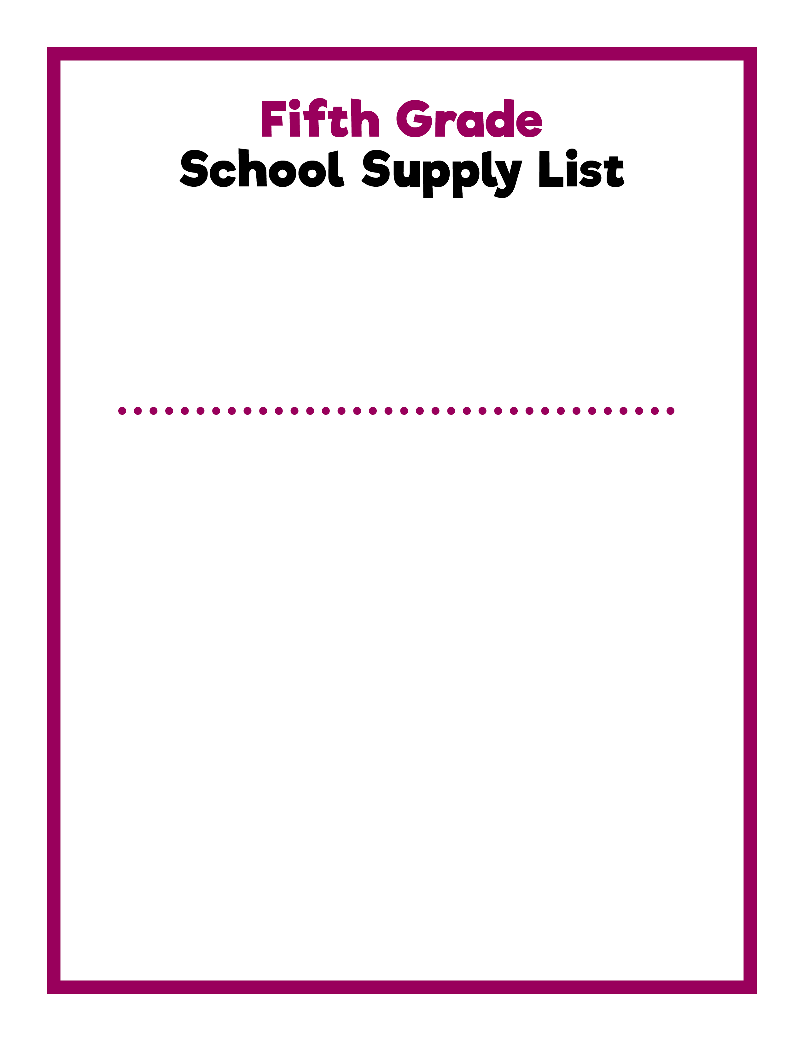
Dear Fifth Grade Families,
I am so excited to be your child’s teacher for the 2021-22 school year. Please make sure your child has the following school supplies ready for the first day of school. I look forward to meeting your child and giving them the best ever start to school!
Sincerely,
NAME
Backpack
Lunchbox
Reusable water bottle
Pencil pouch
Two boxes of 12 sharpened No. 2 pencils
Personal pencil sharpener
12 pink pencil top erasers
One box of 24 crayons
One box of 12 colored pencils
One box of 4 dry erase markers
Two highlighters
Two red pens
Two blue or black ballpoint pens
One black fine point permanent marker
One pair of pointed-tip scissors
One bottle of white school glue
Six glue sticks
Ruler
One pack of index cards
Two wide-ruled composition notebooks
Four wide-ruled spiral-bound notebooks
Three packs of loose leaf, wide-ruled paper
One 1.5” three-ring binder
One packet of dividers
Two two-pocket folders
Two boxes of tissue
One roll of paper towels
One container of Lysol® Disinfecting Wipes
One box of plastic storage bags: gallon, quart, or sandwich
One pair of headphones

